Slide 1
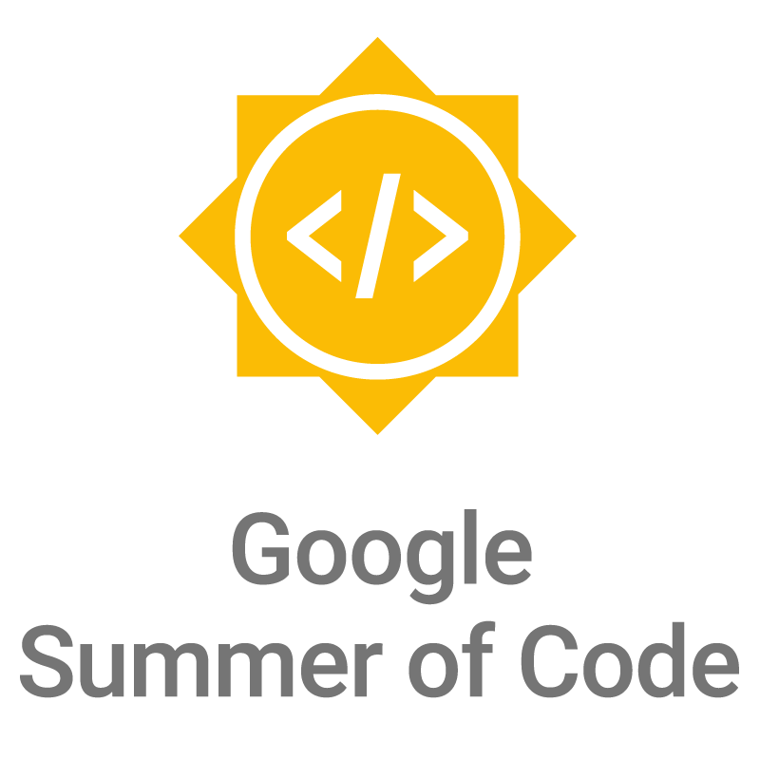



How to get started with Open Source Projects and SoC programs

Slide 2
What is open source?
Computer software where the source code is distributed under an open source license that allows anyone to study, change, improve and distribute the software.
Promotes collaboration
Community of dedicated developers

Slide 3
What is GSoC?
Google Summer of Code (GSoC) is an online, international program designed to encourage university student participation in open source software development.

Slide 4
What are other Summer of Code(GSoC like) programs ?
Outreachy, Summer of KDE, Rails Summer of Code, etc.
Note: application process almost same as for GSoC.

Slide 5
Why contribute?
Absolutely amazing learning experience!
Sense of achievement
Hone your developer skills
Build a strong network when applying for jobs

Slide 6
Why contribute?
Spring board to open source world
For the love of Code
Stipend, fame and the t-shirt

Slide 7
Am I good enough?
Soft Skills
Figure out where to go to get help
Take and respond well to feedback
Work independently
Know when to ask questions

Slide 8
Am I good enough?
Technical Skills
Install and configure software packages
Access to a functioning computer 40 hours a week
Experience using the programming language and operating system.

Slide 9
Pro Tip: Don’t be afraid to apply to projects where you only meet 51% of the listed requirements.
Include a section on how you’ll compensate for or learn the missing skills
demonstrate during the application process that you are working on acquiring those new skills.

Slide 10

How to Apply

Slide 11
Choosing a Project
Shortlist
Ask questions
Re-evaluate your options

Slide 12
Making First Contact
Observe community interactions
Begin participating in conversations
Introduce yourself
Ask questions
Be humble
Don’t be intimidated

Slide 13
Contributing
Setup up development env - 50% of the work
Go through the issue tracker and pick one bite-sized issue
Submit a pr 🎉

Slide 14
Strong candidates
Start early!
Have multiple contributions
Submit proposal early to get feedback from mentors

Slide 15
Proposal
Research, look through project
Be specific about the timeline
Discuss with mentors, ask for feedback
Make a prototype! (optional)

Slide 16
Demo with a sample project

Slide 17
Useful links
Program Site: http://g.co/gsoc
Student Guide: http://g.co/gsoc/resources/manual
Outreachy: https://www.outreachy.org/
Other SoC programs: https://github.com/tapasweni-pathak/SOC-Programs

Slide 18
2018 Program Timeline*
Jan 4: Organization applications open
March*: Students submit their proposals
Late April: Accepted students are announced
Late April-Mid May: Community bonding period with orgs
Mid May-August: Students code the summer away
Late August: Successful student projects are announced
* Exact dates will be announced in November 2017

Slide 19
Questions?

Slide 20
All the Best!

